Slide 1
MIU IEEE TSB 2019
Games Development Team

Slide 2
Team Data
Co-coordinator : Eng. Mohammed Negm
Follow up ; Wallaa Barakat & Roqiah Hamdy
Member; Osama Khattab

Slide 3
Idea
Creating simple arcade Games Using Unity Engine
Using Unity Assets Story for Graphics
First Project Is building Runner Arcade Game with simple Features ; Obstacles, forward & side forces And jumping with Levels that differ in difficulty ”Almost finished”
Second Project : Designing Levels using 3D game kit Unity package “unfinished”

Slide 4
Techniques Required in building
Good knowledge of Unity Engine interface
Knowledge of some basic modeling in unity & Blender
Good Knowledge of programming in C#
Patience^^

Slide 5
References used in Building
YouTube channels “Brackeys & CG Masters”
Udemy Tutorials
Unity Tutorials

Slide 6
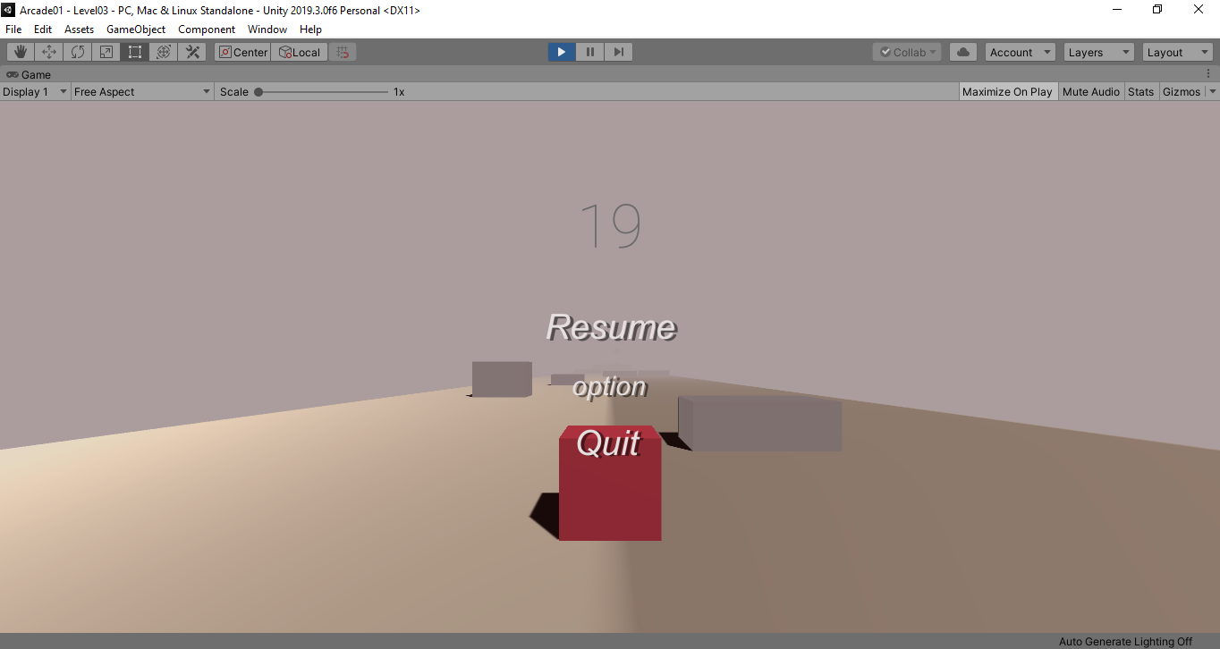
Arcade01

Slide 7
Project parts{1}
Start Menu ; with welcome image
Intro video from Pexels.com https://www.pexels.com/
Intro sound clip from Zapsplat https://www.zapsplat.com/sound-effect-category/ambient/

Slide 8
Three levels
Level 1 ; basic level with player as a cube & obstacles and pause menu
Level 2 ; same as one with more obstacles
Level 3 ; The only level I care about its design with more obstacles and some difficulty.
Basic pause menu in levels
Exit Screen

Slide 9
Future Intentions in First Project
Building Endless Runner Level
Improving project graphics using Blender 2.8 or unity pro builder
Exporting the Game to Android Platform

Slide 10
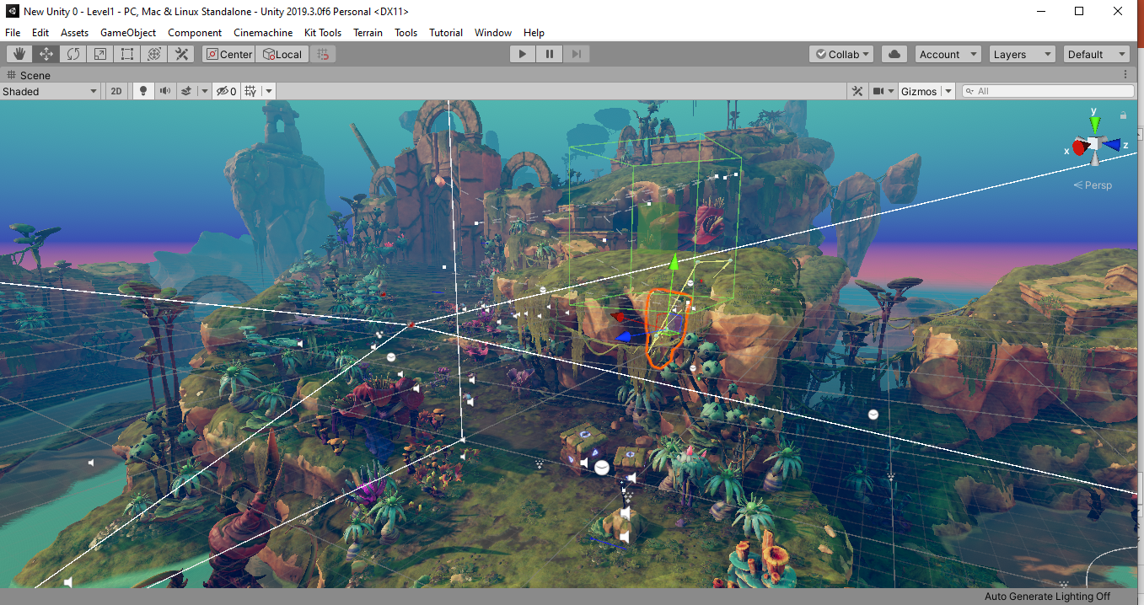
3D Game Kit

Slide 11
Project {2}
Building small level Existing Prefabs & interactables
Putting some difficulty with enemies

